Slide 1
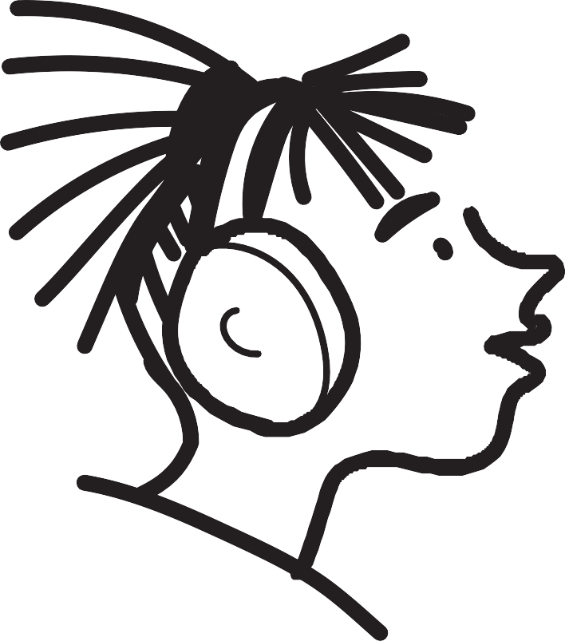
LEARNING SOCIAL SKILLS AND ASSERTIVE BEHAVIOR
in

Slide 2
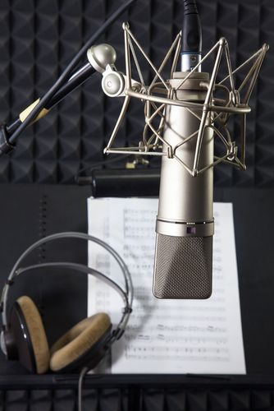
INTRO
Social skills are like superpowers that help us make friends, play together, and get along with others.
We can practice and develop these skills every day to become better at interacting with people around us.

Slide 3
WHAT IS ASSERTIVE BEHAVIOR?
Assertive behavior is a good way of expressing our feelings, thoughts, and ideas.
It means speaking up at the right time and in the right way without being mean or rude to others.

Slide 4
DIFFERENT BEHAVIOR STYLES
Passive/ Inhibited
Assertive
Aggressive
PICTURE BY: pexels-brett-sayles-4007613

Slide 5
PASIVE / INHIBITED
When someone is passive or inhibited, they find it hard to express themselves openly.
They might apologize too much or lack confidence when sharing their feelings and opinions.
Their goal is to avoid conflicts, but it's important to find a balance.

Slide 6
AGGRESSIVE BEHAVIOR
Aggressive behaviour is when someone is too forceful and dominant.
They might use mean words or act in a way that hurts others' feelings.
It's important to remember that being aggressive is not a good way to treat friends.

Slide 7
ASSERTIVE
The best style of behavior is being assertive!
Being assertive means expressing ourselves while also respecting others.
We can share our feelings, desires, and opinions without being bossy or mean.

Slide 8
WHY BE ASSERTIVE
Being assertive helps us have better friendships and better communication with others.
When we are assertive, we treat ourselves and others with respect and kindness.

Slide 9
LET’S PRACTICE
We can try saying things like,
"I don't this activity. Can we do something else?“
"I feel sad when you say mean things. Please be kind to me."

Slide 10
CONCLUSION
Let's practice being assertive and treating everyone with kindness and respect.
Social skills and assertive behaviour are important for making friends and getting along with others.
PICTURE BY: pexels-brett-sayles-4007613

Slide 11
in

